Slide 1
Physiological and Computational Insights into Conflict Tasks
Kane York

Slide 2



Slide 3
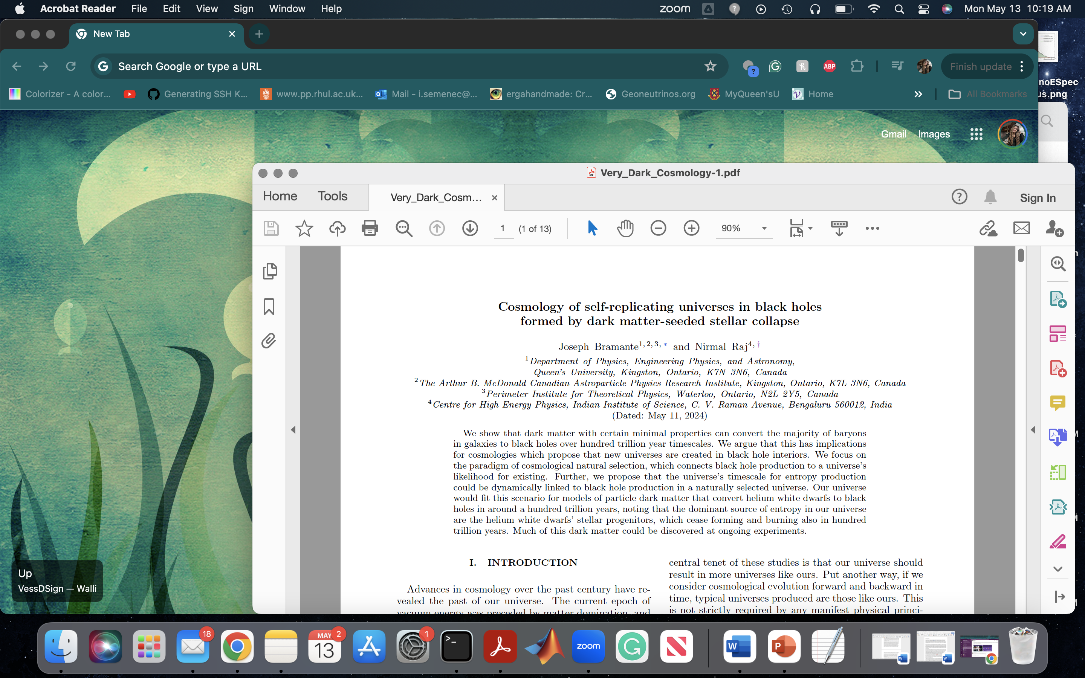


Slide 4
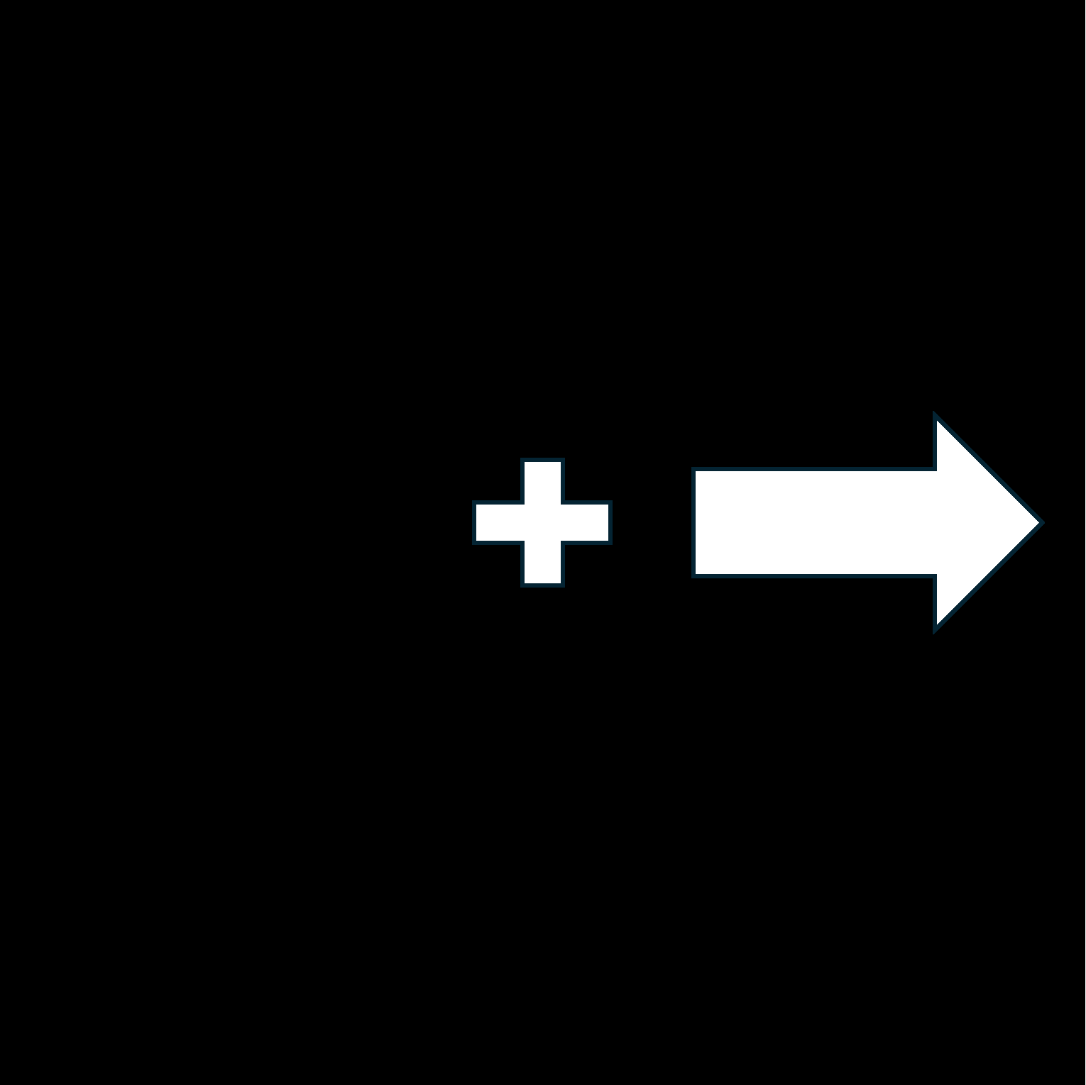
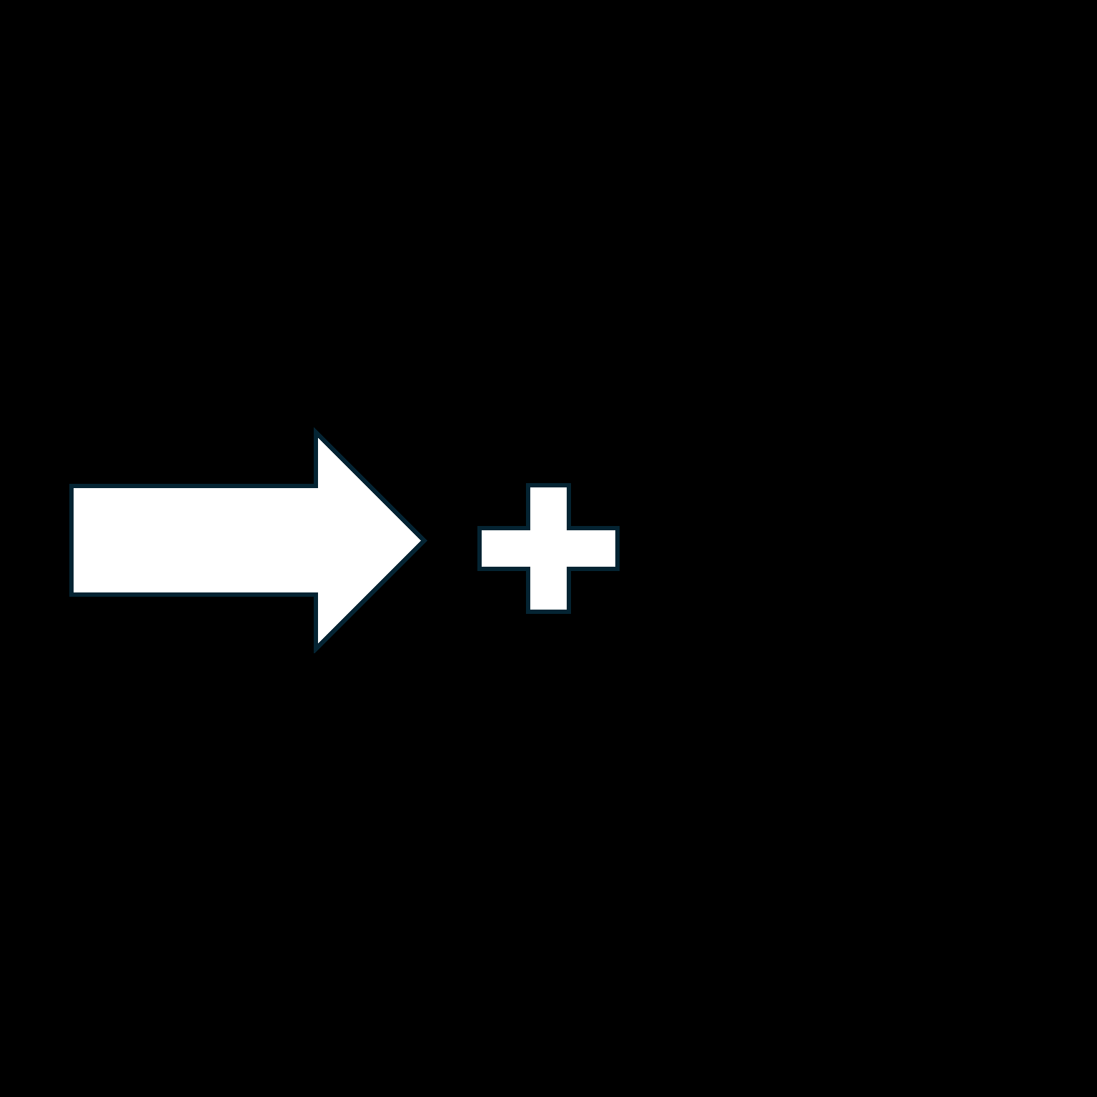


How do we study this conflict?
Simon Task
Simon Arrow Task: report the direction of the arrow while ignoring location
Flanker Task: report the direction of the middle arrow while ignoring the arrows on the left and right
Conflict = difference in reaction time (RT) between congruent and incongruent trials
Congruent
Incongruent
Flanker Task

Slide 5
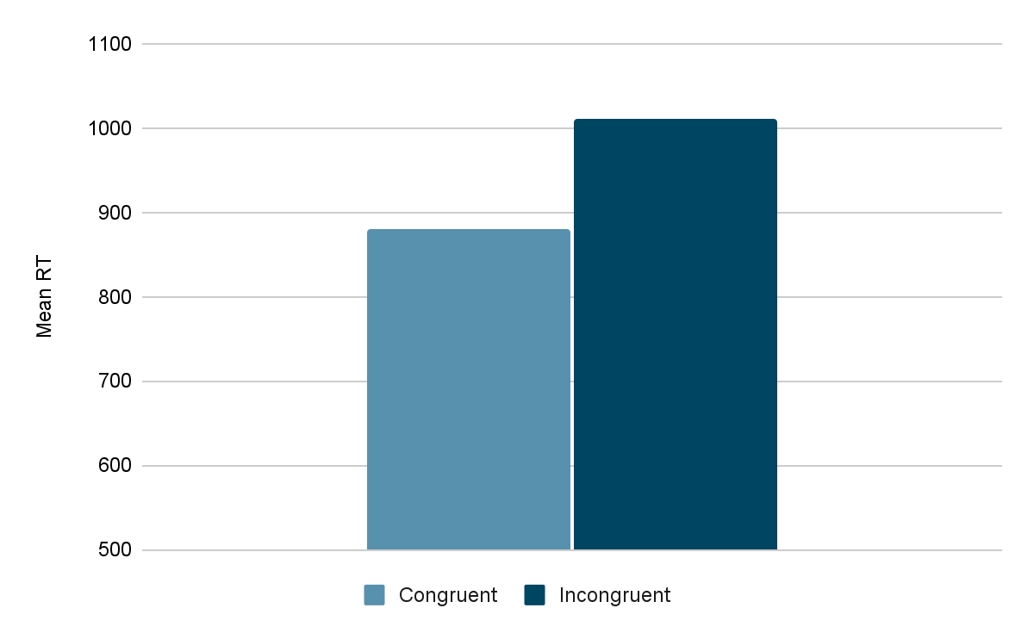
Problems with the Free RT Paradigm
Conflict?
Speed accuracy trade-off (Heitz, 2014)
  Faster but less accurate?
  Slower but more accurate?
RTs may not reflect full processing time; participants respond accurately when they respond faster than usual (Haith et al., 2016)
RTs tend to mirror RTs on previous trials (Wong et al., 2017)

Slide 6
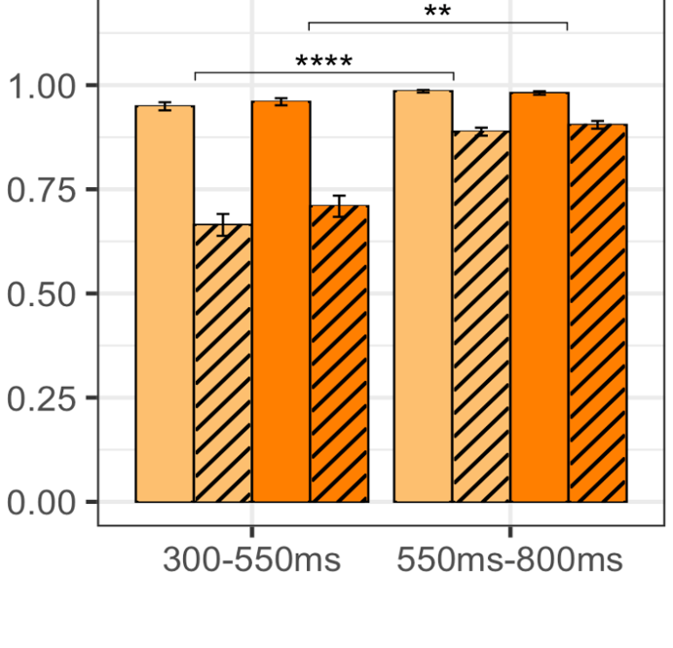
Solutions?
Binning RT and examining accuracy in each bin?
  Hard to get uniform distributions
  Participants don’t always respond when most optimal
Response deadlines?
  Gives too much control to participants on how they respond
Response signaling?
  Too much uncertainty for participants on a trial-by-trial basis

Slide 7
Forced-response Method

Slide 8
RT
Dependent Variable
Independent Variable

Slide 9
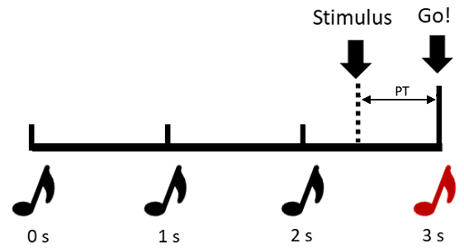

PT

Slide 10
ime (PT)
T
reparation
P

Slide 11
How do the data look?

Slide 12
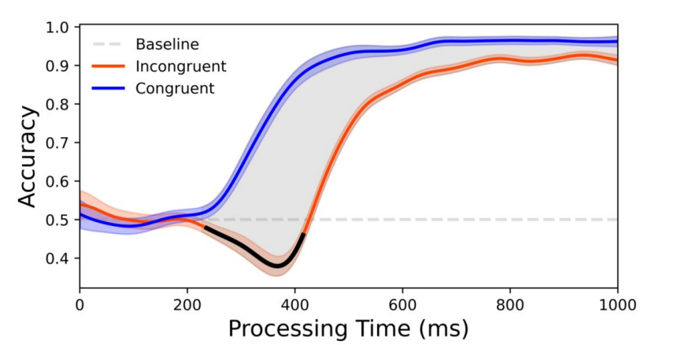
Congruent
Incongruent
Lee et al., 2024

Slide 13


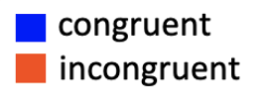
Response Preparation Model
Assumptions
Behavior is the result some combination of preparation states
Response preparation latency is normally distributed
Habitual and goal-directed responses are prepared independently and in parallel
Goal-directed responses override habitual responses once they are prepared
Response preparation is imperfect and action slips occur
𝜇_{H}
Density
habit
goal
𝜇_{G}
𝜎_{H}
𝜎_{G}
Time (ms)
Accuracy
Haith, Pakpoor, Krakauer (2016) Journal of Neuroscience
Hardwick et al., (2019) Nature Human Behavior
Adkins & Lee (2023) Journal of Cognitive Neuroscience
Time (ms)

Slide 15
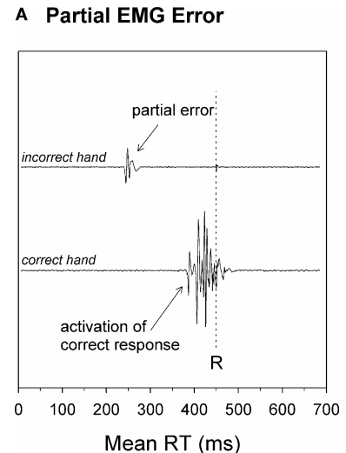
van den Wildenberg et al., 2010

Slide 17
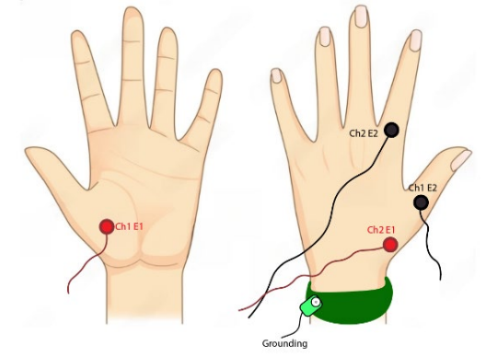
Simon Task
EMG
Congruent
Incongruent
Flanker Task

Slide 18
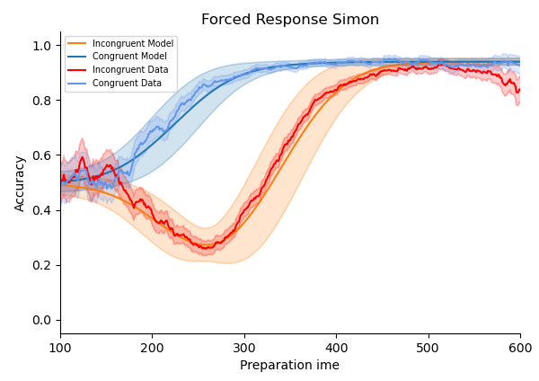
Simon Task
Congruent
Incongruent

Slide 19
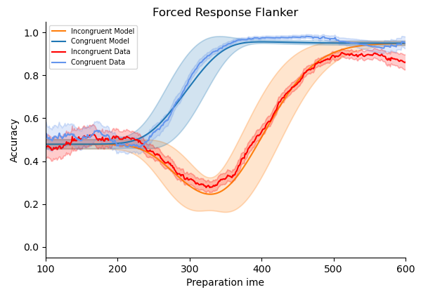
Flanker Task
Congruent
Incongruent

Slide 20
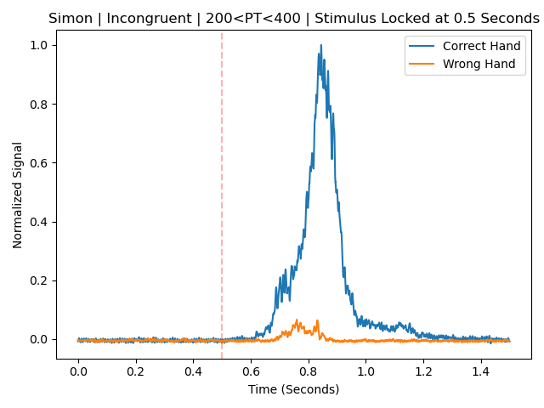
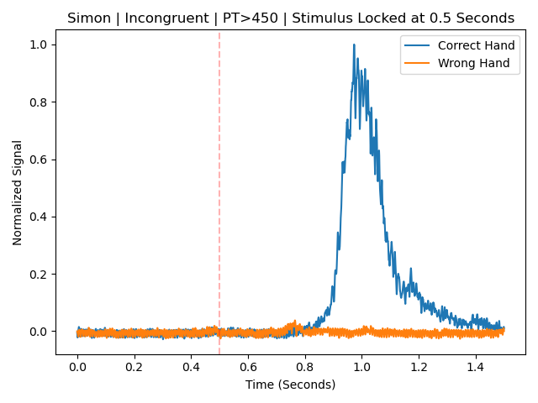
Normalized EMG Traces (Simon Task)

Slide 21
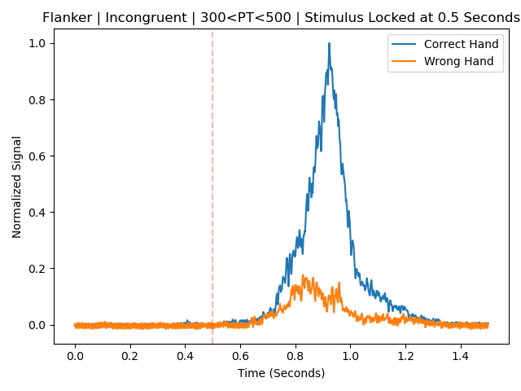
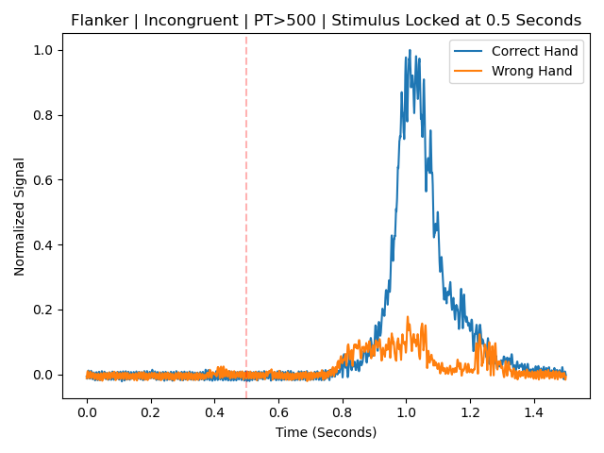
Normalized EMG Traces (Flanker Task)

Slide 22
Summary
Traditional free RT approaches fail to give us the entire image of conflict processing
The forced response paradigm allows us to capture the temporal landscape of conflict processing
Our response preparation model offers insights into plausible mental computations and testable predictions
EMG gives us a possible physiological window into goal processes overriding habit processing

Slide 23
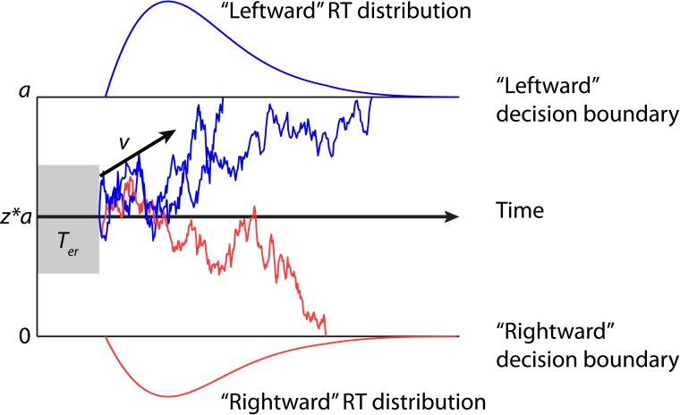
Future Directions
𝜇_{H}
Density
habit
goal
𝜇_{G}
𝜎_{H}
𝜎_{G}
VS
Time (ms)
Accuracy
Time (ms)

Slide 24
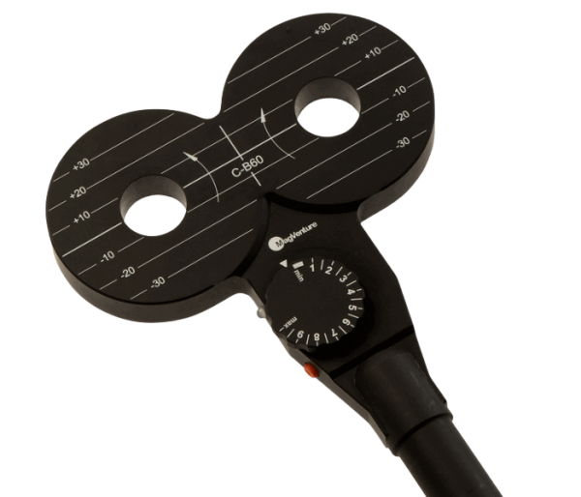
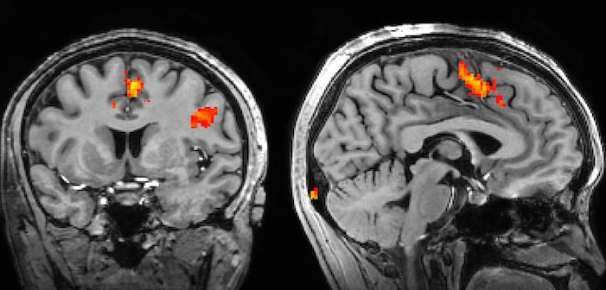
Future Directions

Slide 25

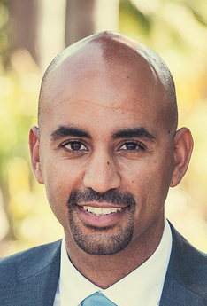
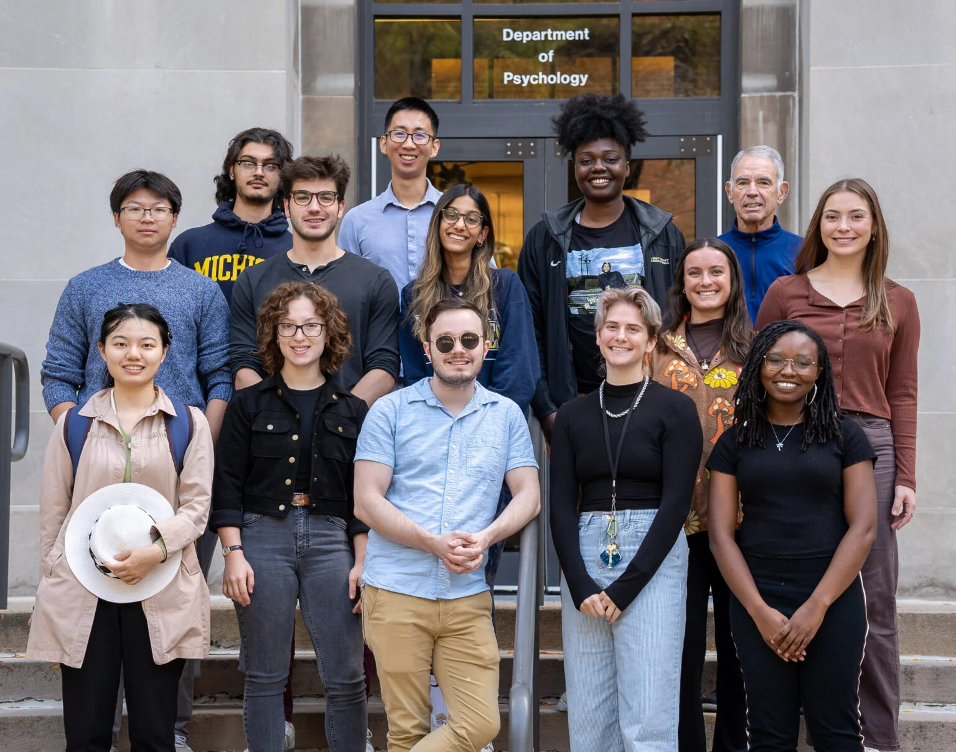
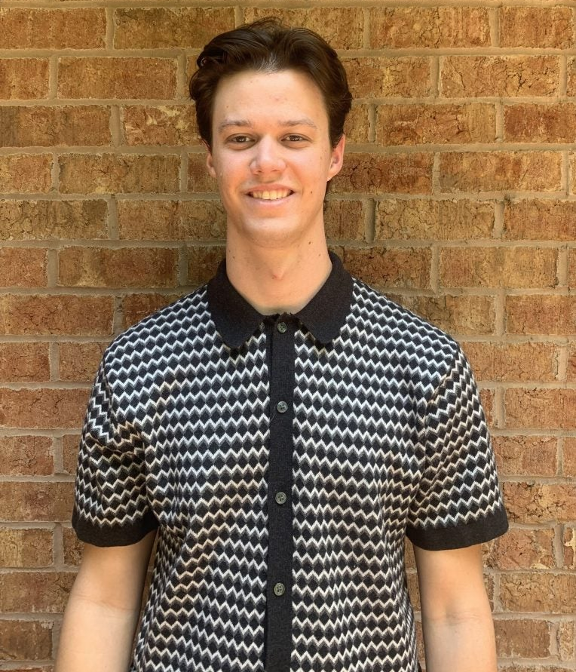
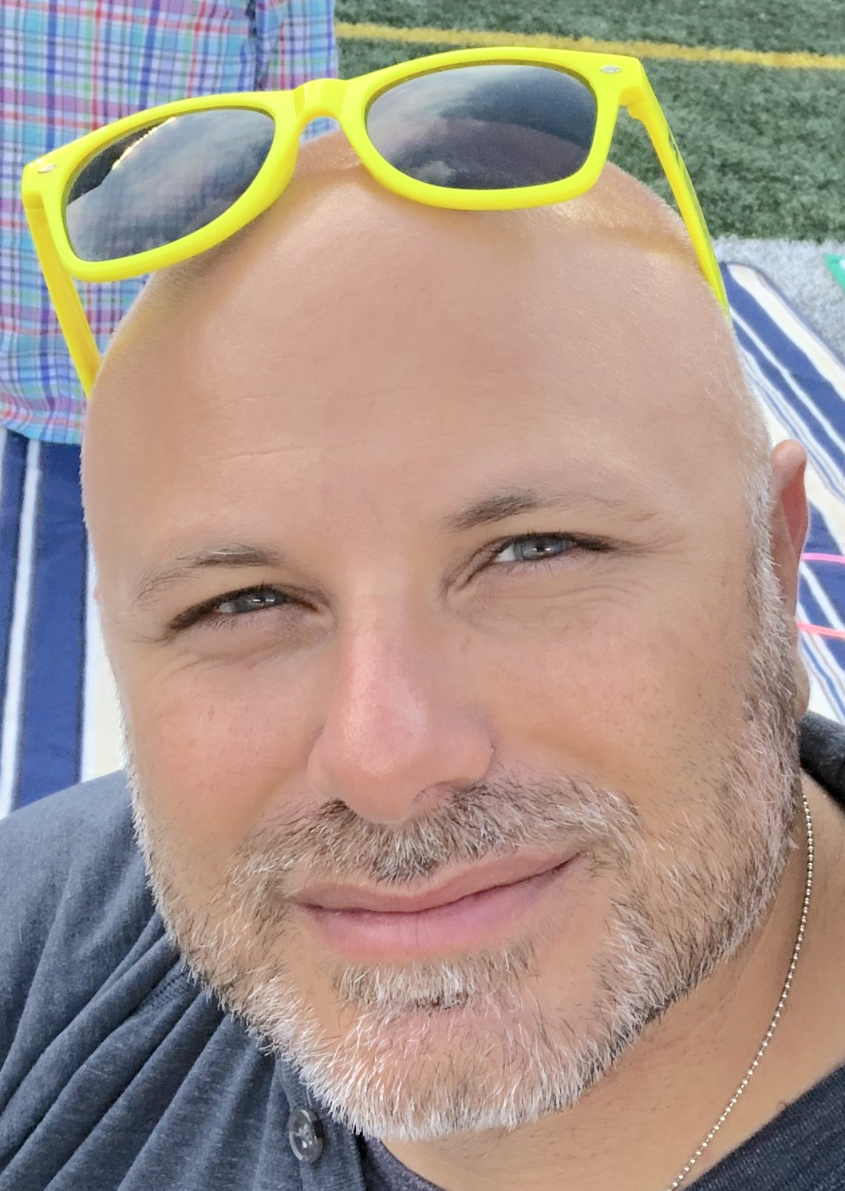

Acknowledgements
Jonides Lab
CoCoa Lab
John Jonides, Ph.D.
Han Zhang, Ph.D.
Jahla Osborne
Su Wang
Maddie Quirk
Sarah Liberatore
Taraz Lee, Ph.D.
Jacob Sellers
B2Lab
Michael Vesia, Ph.D.

